Slide 1

CSE102
Algorithmic Foundations And
Problem Solving
Coping with the Limitations of Algorithm Power
Dr Wenjin Lu
Department of Computer Science
Acknowledgment: The slides are adapted from ones by Dr. Prudence Wong

Slide 2
Tackling Difficult Combinatorial Problems
There are two principal approaches to tackling difficult combinatorial problems (NP-hard problems):
  Use a strategy that guarantees solving the problem exactly but doesn’t guarantee to find a solution in polynomial time
  Use an approximation algorithm that can find an approximate (sub-optimal) solution in polynomial time

Slide 3
Exact Solution Strategies
exhaustive search (brute force)
  useful only for small instances
dynamic programming
  applicable to some problems (e.g., the knapsack problem)
backtracking
  eliminates some unnecessary cases from consideration
  yields solutions in reasonable time for many instances but worst case is still exponential
branch-and-bound
  further refines the backtracking idea for optimization problems

Slide 4
Backtracking
Construct the state-space tree
  nodes: partial solutions
  edges: choices in extending partial solutions
Explore the state space tree using depth-first search
“Prune” nonpromising nodes
  dfs stops exploring subtrees rooted at nodes that cannot lead to a solution and backtracks to such a node’s parent to continue the search

Slide 5
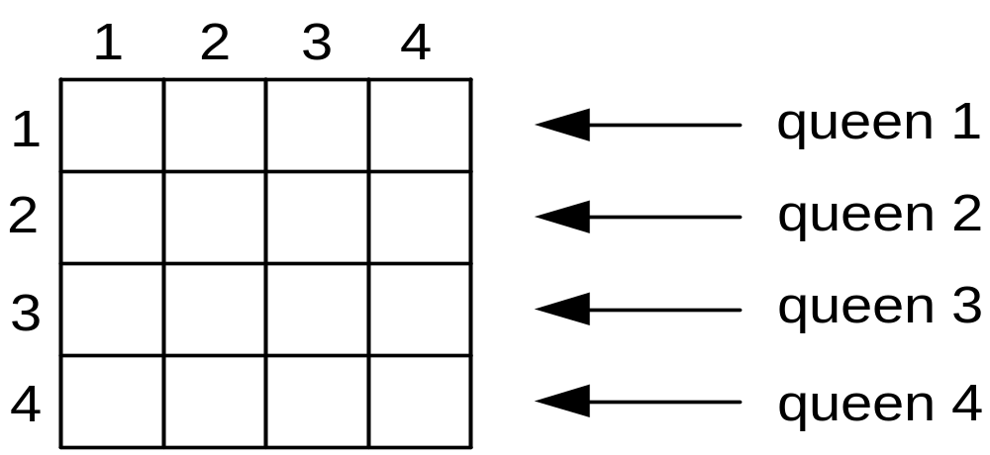
Example: n-Queens Problem
Place n queens on an n-by-n chess board so that no two of them are in the same row, column, or diagonal http://en.wikipedia.org/wiki/Eight_queens_puzzle

Slide 6
Example: n-Queens Problem
What is the state-space?
What is the relationship between the states?

Slide 7
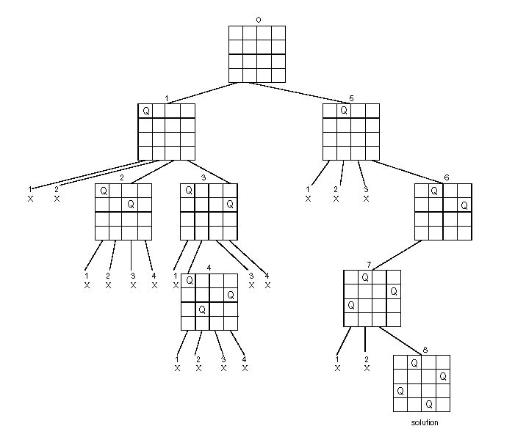
State-Space Tree of the 4-Queens Problem

Slide 8
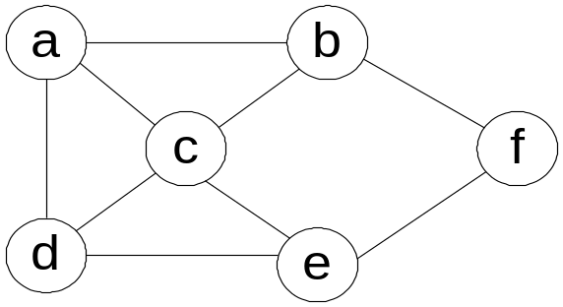
Exercise: Hamiltonian Circuit Problem
What is the state-space?
What is the relationship between the states?

Slide 9
Exercise: Hamiltonian Circuit Problem
0
a
1
b
2
9
c
f
3
6
d
e
10
e
4
7
8
e
d
f
11
Dead end
c
Dead end
5
f
12
d
Dead end
a
solution

Slide 10
Example: Subset-Sum Problem
Find a subset of a given set S={s₁, …, s_{n}} of n positive integers
whose sum is equal to a give positive integer d .
For example: S ={ 3, 5, 6, 7} d=15
What is the state-space?
What is the relationship between the states?

Slide 11
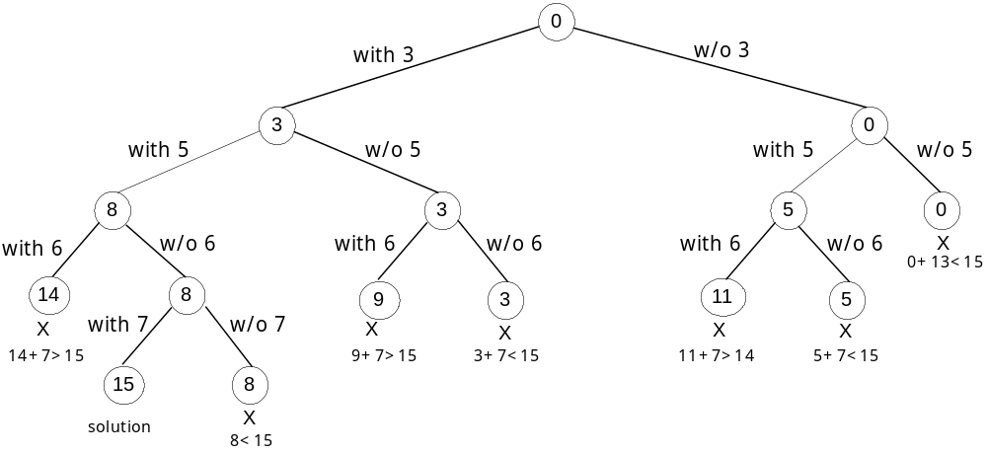
Example: Subset-Sum Problem
S={3, 5, 6, 7}
d=15

Slide 12
Comments on Backtracking
Typically, backtrack is applied to difficult combinatorial problems for which no efficient algorithms for finding exact solutions possibly exist.
Unlike exhaustive search approach, which is doomed to be extremely slow for all instances of a problem, backtrack at least holds a hope for solving some instances of nontrivial size in an acceptable amount of time.
Even if backtracking does not eliminate any elements of a problem’s state space and ends up generating all its elements, it provides a specific technique for doing so, which can be of value in its own right.

Slide 13
Branch-and-Bound
An enhancement of backtracking
Applicable to optimization problems
For each node (partial solution) of a state-space tree, computes a bound on the value of the objective function for all descendants of the node (extensions of the partial solution)
Uses the bound for:
  ruling out certain nodes as “nonpromising” to prune the tree – if a node’s bound is not better than the best solution seen so far
  guiding the search through state-space

Slide 14
Example: Assignment Problem
Select one element in each row of the cost matrix C so that:
no two selected elements are in the same column
the sum is minimized
Example
Job 1 Job 2 Job 3 Job 4
Person a 9 2 7 8
Person b 6 4 3 7
Person c 5 8 1 8
Person d 7 6 9 4
Lower bound: Any solution to this problem will have total cost
at least: 2 + 3 + 1 + 4 (taking smallest value from row)
(or 5 + 2 + 1 + 4, taking smallest value from column)

Slide 15
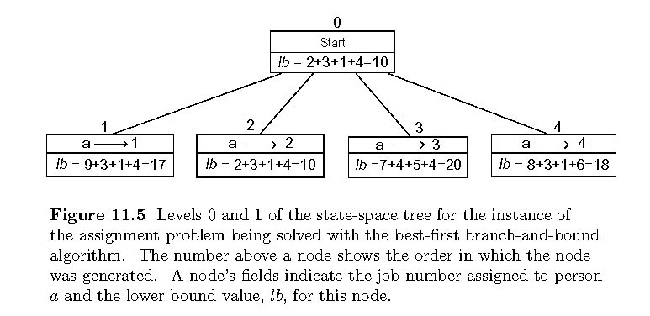
Example: First two levels of the state-space tree

Slide 16
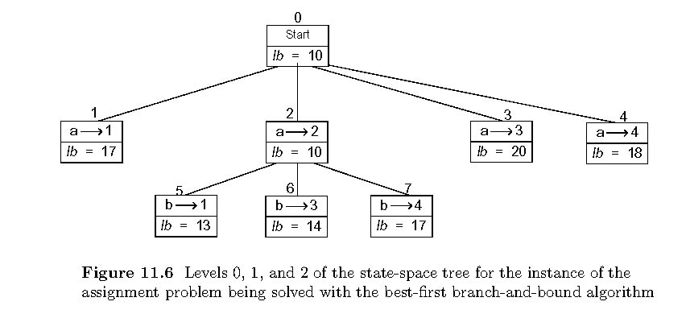
Example (cont.)

Slide 17
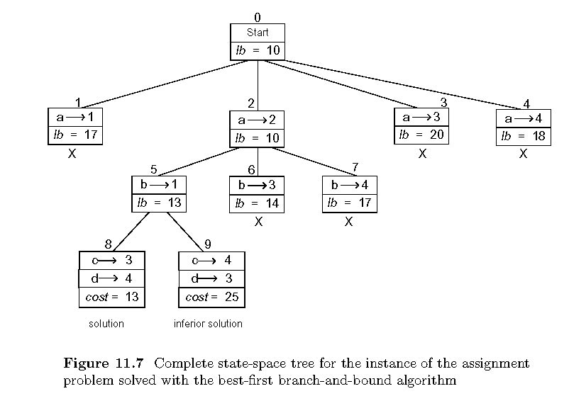
Example: Complete state-space tree

Slide 18
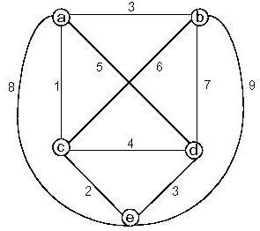
Example: Traveling Salesman Problem
a b c d e
a 0 3 1 5 8
b 3 0 6 7 9
c 1 6 0 4 2
d 5 7 4 0 3
e 8 9 2 3 0
What is the state-space?
What is the relationship between the states?
What is a reasonable lower bound? (Using distance matrix)
lb = Σ (distances of two nearest cities of v in G)/2

Slide 19
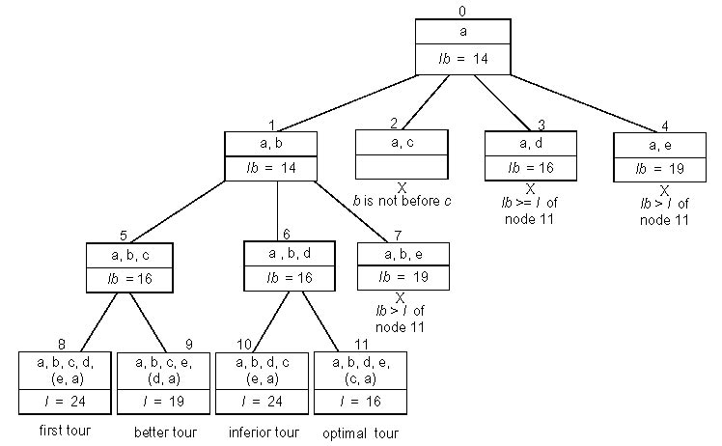
Example: Traveling Salesman Problem
a b c d e
a 0 3 1 5 8
b 3 0 6 7 9
c 1 6 0 4 2
d 5 7 4 0 3
e 8 9 2 3 0
By requiring b before
C, we can reduce space by half

